Slide 1

ONLINE GROCERY SHOP
DEPARTMENT OF
COMPUTER SCIENCE ENGINEERING
(2021-2025)
Submitted By :-
NAMAN KUMAR (SBU211326) INDRANIL NANDY (SBU210309)

Slide 2
CONTENTS
INTRODUCTION
OBJECTIVE
OUTPUT
FUTURE SCOPE
LIMITATIONS
BIBLIOGRAPHY

Slide 3
INTRODUCTION
In order to flourish the economy ,technology is the foremost tool to access with. Requirement to evaluate the standard of living of the consumers faster growing supposed to be the ultimate accelerator . “Faster Growing” requires technological efficiency which can boost the propensity to consume which will be resulting in booming the GDP of any nation.
Upliftment of the better standard of living in accordance with the evaluation of time, making easier to access the market of conspicuous consumer’s good is the most required framework to be done.
Technological Framework for establishing stabilized Online Grocery Market is the trigger to push the standard of living of individuals for a stable future.
Existing uncertain disputes might be mitigated through the facilitation of Online Platform for selling and purchasing of Grocery Goods resulting in secured future with minimum impact of natural calamitic disaster which is the most important determinant to push the economy downwards.

Slide 4
OBJECTIVE
The objective of this presentation is to provide a comprehensive understanding of the online grocery shopping model. We aim to explore how this digital innovation transforms the traditional grocery shopping experience by offering convenience, time savings, and accessibility for consumers.
The goal is to make use of advanced technology, optimized logistics, and personalized services to meet evolving customer needs while supporting sustainable practices and enhancing overall customer satisfaction.
Increase the operation of selling and purchasing of daily necessity goods will be evident enough for technological efficiency.

Slide 5
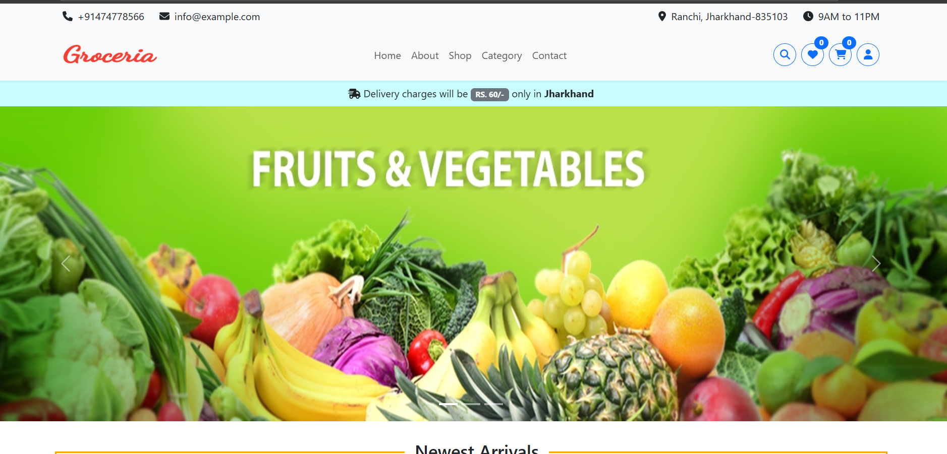
OUTPUT
Main Page

Slide 6
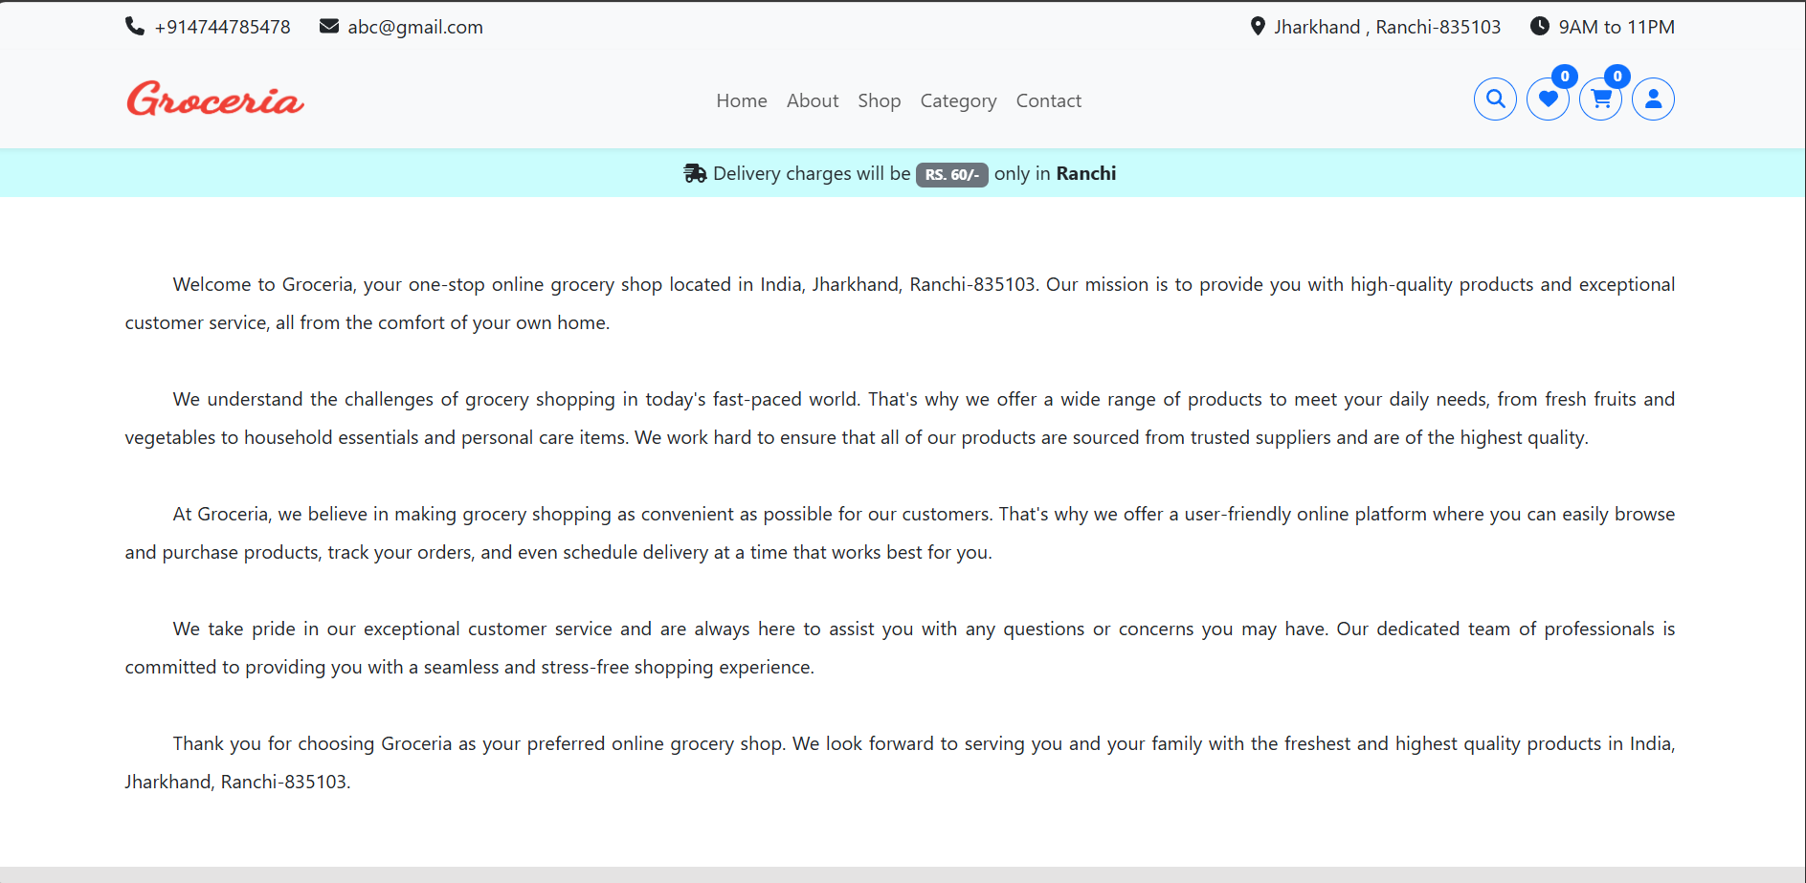
OUTPUT
About page

Slide 7
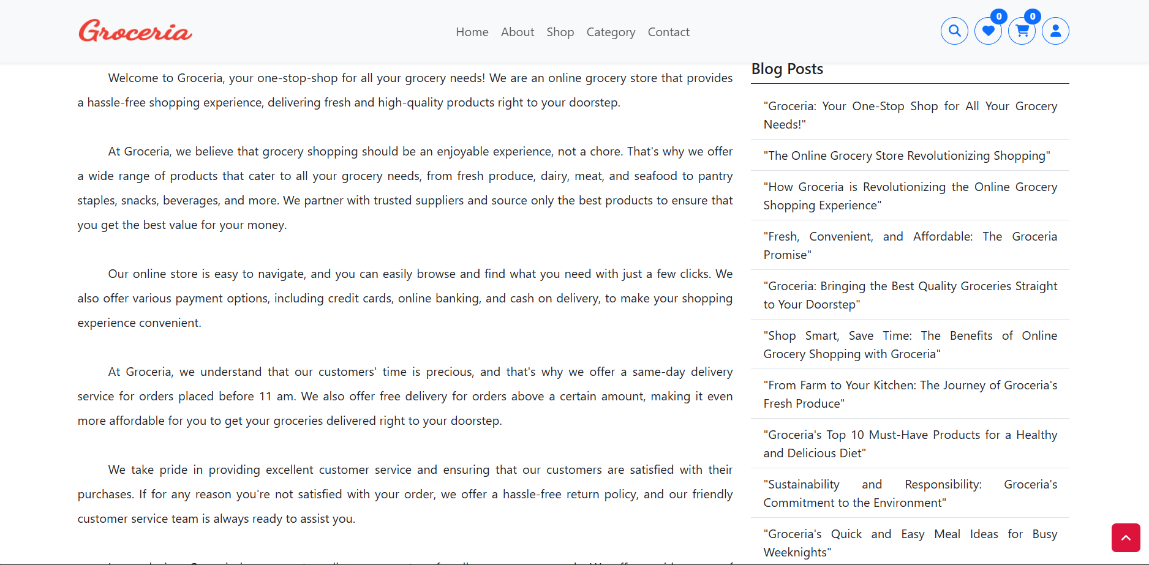
OUTPUT
Blog Page

Slide 8
FUTURE SCOPE OF PROJECT
Expansion of Reach:
Extending services to rural and underserved areas, making online grocery shopping accessible to a broader audience.
Integration of Advanced Technologies:
Incorporating AI for personalized recommendations, chatbots for enhanced customer support, and machine learning for demand forecasting and inventory optimization.
Partnership Opportunities:
Collaborating with local farmers and suppliers to offer fresh and organic produce.
Partnering with third-party delivery services for quicker and more efficient order fulfillment and much more.

Slide 9
LIMITATION
Some limitations of Online Grocery Shopping are:
Logistical Challenges:
Ensuring timely delivery, especially in remote areas or during peak demand periods, can be difficult.
Maintaining product quality, particularly for perishable items, during transportation.
Limited Product Inspection:
Customers cannot physically inspect items for quality, freshness, or size before purchase.
Security and Privacy Concerns:
Risks of data breaches or misuse of personal and payment information.

Slide 10
BIBLIOGRAPHY
WEBSITES:
https://www.w3schools.com
https://geeksforgeeks.org
https://stackoverflow.com
PEOPLE:
Project Guide: Dr. Megha Sinha
Group Members : Naman Kumar (SBU211326)
Indranil Nandy (SBU210309)

Slide 11
THANK YOU

